Slide 1

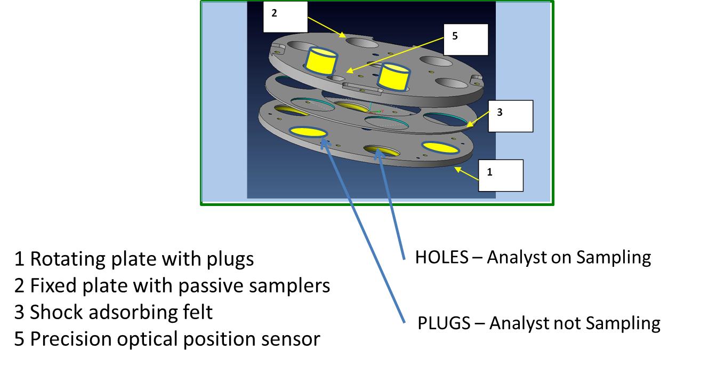
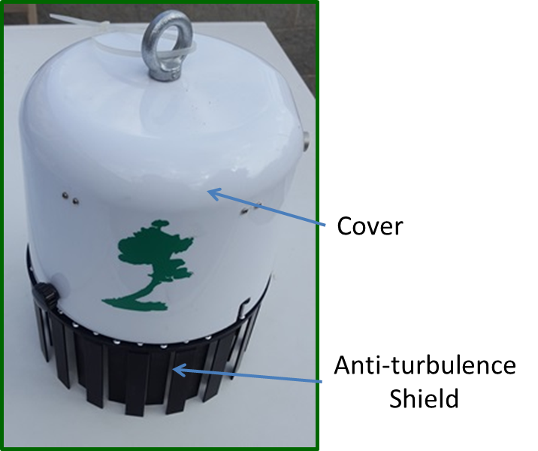
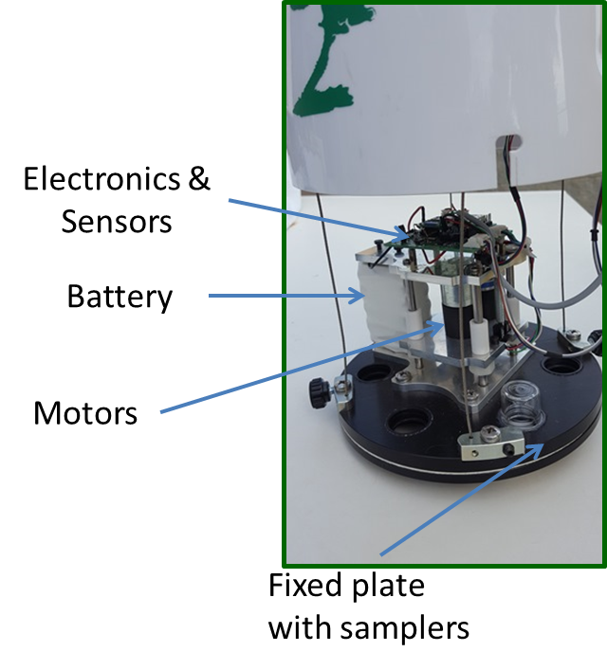
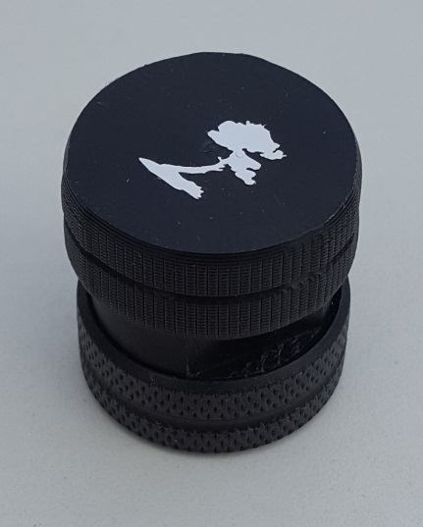
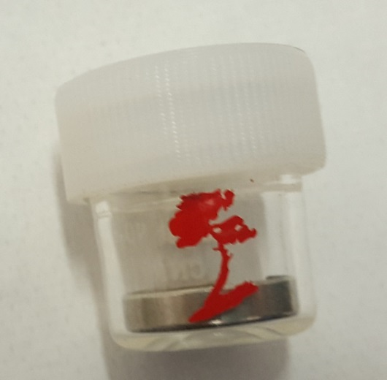
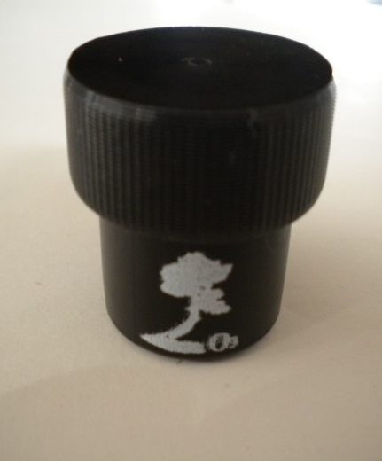
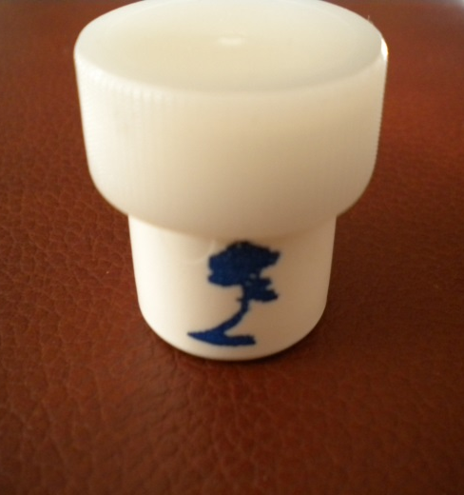
A New Device for Automatic Sampling of Passive Samplers and Monitoring of Air Pollutants (PAS06/15)
Ivo Allegrini – ENVINT srl, Montopoli di Sabina (RI), Italy
ABSTRACT
This paper presents a contribution toward the general objective of air pollution monitoring with sufficient accuracy and time discrimination. It describes a device which consists of an automatic passive sampler exposure intended for Analyst® type passive samplers. Exposition of samplers are controlled by a rotating plate which accommodate plugged and unplugged holes. According to a programmed time sequence, input to the system via Wi-Fi, and to external events, different passive samplers may be exposed accordingly. The device automatically records Temperature and relative Humidity. Other analog data (I²C standard) can be also read and stored. In addition, the programmed sequence may be changed by digital inputs, controlled in turn by external events. This complete and flexible configuration in sampling and data acquisition, makes the system very suitable to expand the applications of passive samplers in indoor and ambient monitoring. Among these, Ozone studies, monitoring in schools, industrial emissions, accidental release of pollutants may be considered the most promising ones.
Basic of PAS 06/15
Open holes in coincidence with the samplers allow the collection of pollutants.
Closed holes prevent the diffusion of air into the passive sampler, than sampling is stopped
Advantage of Passive Samplers
They can be used for a high number of pollutants,.
Passive samplers can be adapted to almost all gaseous pollutants considered by current legislations in most Countries (Criteria Pollutants) and by most requirements in the field of air quality monitoring and assessment.
Measurement timeframes are fully compatible with the said legislations and they can be extended to periods of time of several months.
They do not require electric supply for sampling pumps, then they can be used in remote locations or where power is not available.
Accuracy and precision of the analytical methods are fully acceptable, especially for the so-called “preliminary assessment” or “indicative measurements”.
They can be also used for the control of working sites and for indoor environments where exposition of “weak people”, e.g., children, elders, hospitalised, etc. is essential
PAS06/15 Hardware
Analyst ® Passive Samplers
Analyst Passive samplers offer additional advantages in terms of reliability, stability, accuracy and flexibility for both indoor and outdoor applications
Features of PAS 06/15
Automatic sequential sampling of passive samplers.
Start simultaneously the sampling steps in all sampling sites through date and time programming.
Automatic sampling according to accumulation on fixed time intervals.
Start or interrupt sampling in presence of pre-defined conditions (up to 3 digital inputs meaning up to 8 different conditions).
Sampling one or more passive samplers according to meteorological variables such as wind speed or wind direction.
Automatically records of environmental parameters T, RH (and P)
Monitors and collect data by several analog inputs by I²C interface
Simple connections though Wi-FI and Android OS Tablets for programing and data download
H2S NO2 O3 SO2
TYPICAL ANALYST PASSIVE SAMPLERS BY ENVINT
Passive Samplers (Including ANALYST®) are limited in that
They are not suitable for sequential sampling where, after a certain amount of time, it is required to stop the sampling on a passive sampler and then start sampling on a new one for another period of time.
Passive samplers do not allow sampling for a fixed periods of time since, unless an operator remove them, they continue to sample pollutants from the air.
They cannot be controlled on changing conditions related, for instance, to meteorological situations.
They are always active. This limitation is very important since it does not allow to measure concentrations and expositions of important group of people according to their exposition to pollutants. For instance, monitoring in schools after lessons is not useful since it dilutes and confuses the data gathered during the students permanence.
In order to overcome these limitations, ENVINT srl introduces the
PASSIVE SAMPLER PAS06/15
automatic sampler
Preliminary Results
Contamination Test
6 BTX Analyst exposed for one month with plugs in all holes .
Observed equivalent concentrations were below MDC (0,5 µg/m³) of Benzene
Results: Blanks are not contaminated
Hydrogen Sulphide in room with open /close window
2 Analyst samplers for Hydrogen Sulphide have been alternatively exposed from 8:00 AM to 8:00 PM and from 8:00 PM to 8:00 AM in a room with windows normally open during the day:
Results: Day time concentration: 0,6 µg/m³ Nigh time concentration: 1,6 µg/m³
Ozone in Daytime (8 h maximum)
2 Analyst samplers for Ozone have been alternatively exposed from 10:00 AM to 6:00 PM and from 6:00 PM to in open atmosphere in July 2017. Location: west of Rome
Results: (Still under check) 8h Conc: 105 µg/m³ Nigh time concentration: 45 µg/m³
PAS 06/15 is a major breakthrough in monitoring air pollution in ambient and indoor atmosphere
giving a significant contribution to ENVINT mission:
Our mission is innovation in the monitoring of air quality (www.envint.it)
NOTE: Analyst ® Passive Samplers is a trademark by ENVINT srl

