Slide 1
ENVINT srl and US_EPA Fence Line Monitoring Rule for the Evaluation of Diffuse Pollution by Refineries

Slide 2
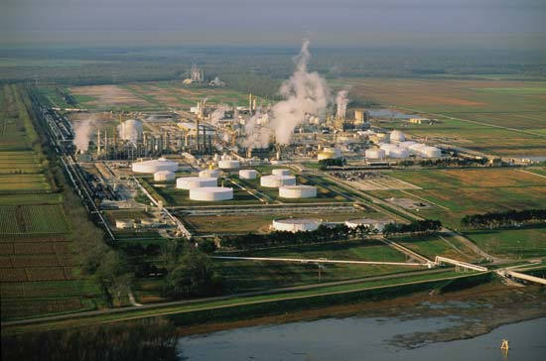
U.S EPA FENCELINE MONITORING RULE
By 2019 refineries will be required to measure diffuse Benzene emissions along the fenceline.

Slide 3
The EPA regulation
On September 29, 2015, EPA issued final rule ”Final petroleum refinery sector risk and technology review and new source performance standards”
The rule becomes effective on Feb. 1, 2016 and existing sources have to comply by Feb. 1, 2019
EPA requires industries to reduce emissions from flares, storage tanks, delayed coking units, and implement fence line monitoring of Benzene
Details are available on: http://www.regulations.gov/#!documentDetail;D=EPA-HQ-OAR-2010-0682-0700

Slide 4
Targets of regulation
This action finalizes the residual risk and technology review conducted for the Petroleum Refinery source categories regulated under national emission standards for hazardous air pollutants (NESHAP) Refinery MACT 1 and Refinery MACT 2.
Although Refineries have diffuse emissions of several HAPs (Hazardous Air Pollutants), EPA selected Benzene as the target Analyte to be used as surrogate for HAP
In addition, the approach may be very useful in monitoring odorous species emitted by the plant causing nuisance and/or chemical risk to population

Slide 5
Monitoring Technique
Several monitoring techniques are available for Benzene monitoring. Among these, EPA selected:
  Method 25 Passive Tubes
  Method 25A Active Tubes
  UV-DOAS
  DIAL
  FTIR
  Passive FTIR / UV
  EPA defines a Benzene concentration action level of 9µg/m³ and then decided that only Method 25, Method 25A and UV-DOAS have sensitivity to measure Benzene well enough in this application.
  EPA concludes that implementation of Method 25 is the least expensive and defines this as a minimum requirement

Slide 6
Monitoring Requirements - General
Benzene concentration values as 2 week values and a yearly ”running” average of 26 values is calculated
Values are corrected for background contributions by subtraction of the smallest result
The result is compared to a 9µg/Nm³ action level
If action level is exceeded the operator shall initiate a root cause analysis to determine the cause and appropriate corrective actions

Slide 7
Monitoring Requirements – Ancillary equipment
A meteorological station is required. A minimum 10m mast with temperature, barometric pressure, wind speed and wind direction is needed.
Data should be collected and report every hour

Slide 8
Monitoring Requirements – Sampling Strategy
If passive tubes are used the number of stations that must be installed increases with size of the refinery according to the following suggestion:
  Up to 1.7km x 1.7km : 12 stations
  Up to 2.5km x 2.5km : 18 stations
  Above 2.5km x 2.5km : 24 stations
Add one duplicate tube for every 10 samples and at least 2 blanks
If sources are located closer than 50m from the fenceline, double the number of stations
Sampling Period is 14 days, thus every two weeks all the tubes have to be exchanged and sent to laboratory for analysis

Slide 9
ENVINT srl is fully fitting EPA monitoring requirements
ENVINT provides ANALYST® BTX passive samplers for which the minimum detectable sensitivity is well below 1 µg/m3 for two weeks exposition time, i.e., 10to20 times below the required action level.
Daytime/night resolution may be achieved through the use of a limited number of PAS 06/15 automatic samplers which allows discrimination according to user requirements and programs
PAS 06/15 samplers are specifically designed to accept data by meteorological sensors with a time resolution of 1 minute. Data may be downloaded for further calculations.
Holders and samplers for BTX passive samplers may also accommodate complementary passive samplers intended for the monitoring of other species (Sulphur Dioxide, Hydrogen Sulphide, Nitrogen oxides, etc.)
ENVINT may provide analytical services for the analysis of passive samplers reducing the cost of monitoring through recirculation of components and optimization of analytical procedures.

Slide 10
Refineries Fence Line and ENVINT products
PAS 06/15 ANALYST Automatic Sampler
Combined ANALYST BTX and H2S sampler
Standard ANALYST BTX sampler
Fence Line

Slide 11
Refineries Fence Line and ENVINT products
ENVINT Srl provides full equipment for fence line monitoring to evaluate diffuse pollution in refineries and other plant by providing:
BTX ANALYST Passive Samplers
PAS 06/15 Automatic Sampler
Other ANALYST such as H2S, NOX, SO2, etc.
Planning of monitoring campaigns
Analytical Service
Data interpretation and analysis

